Slide 1
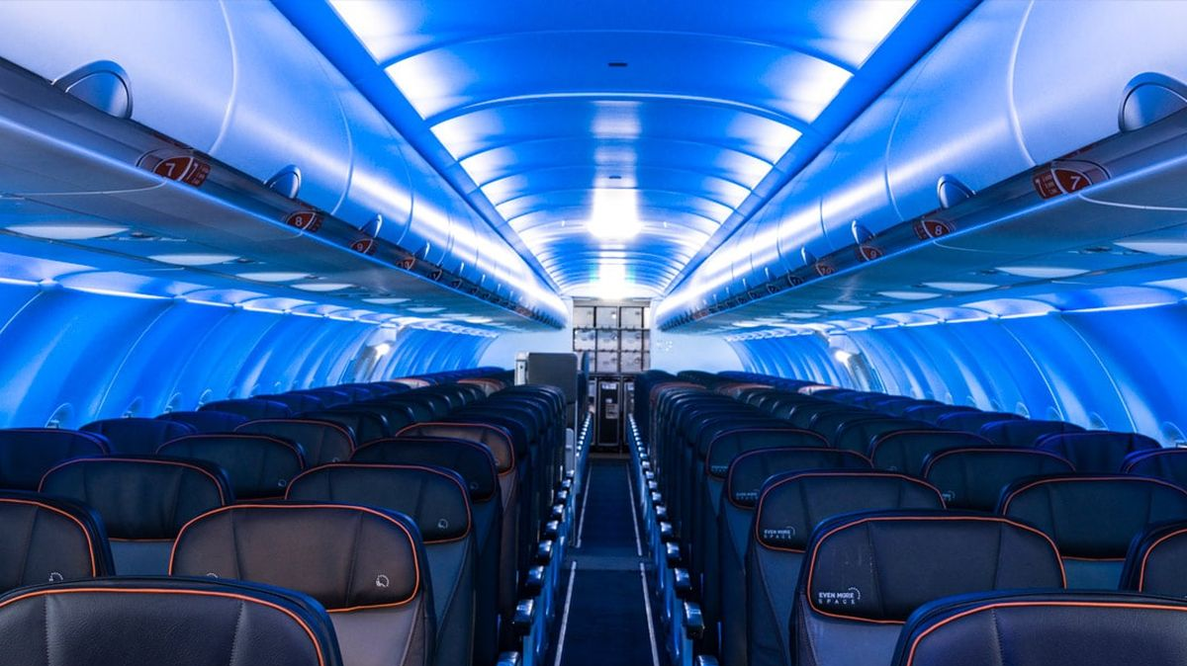
The Safety of Air Travel
Andrea Fox
March 6, 2021
DSC640 – T301 Data Presentation & Visualization
Notes:
Hello everyone and thank you for joining me. Today I want to talk to you about the safety of air travel

Slide 2

Table of Contents
The problem
Investigation
Findings
Takeaways
Notes:
Today we’re going to cover:

Slide 3
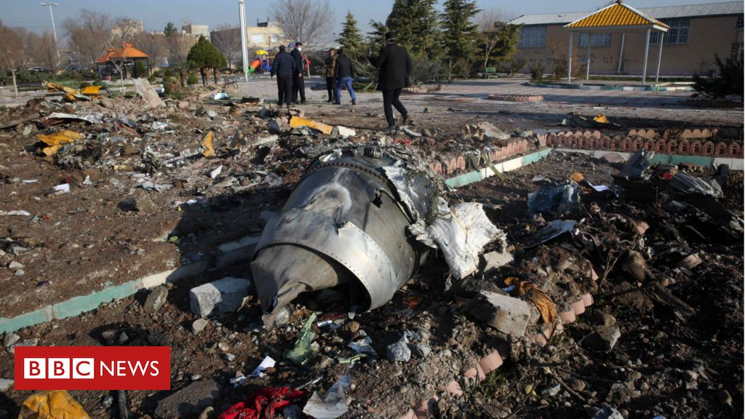
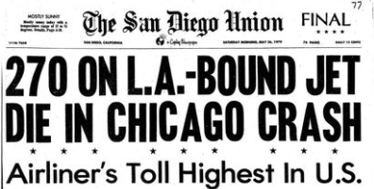
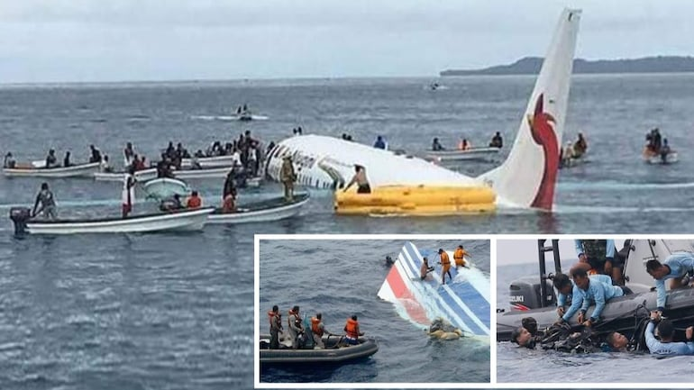
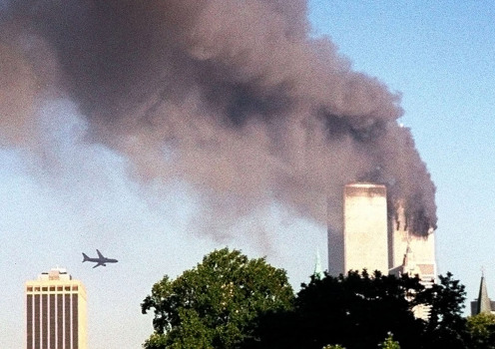
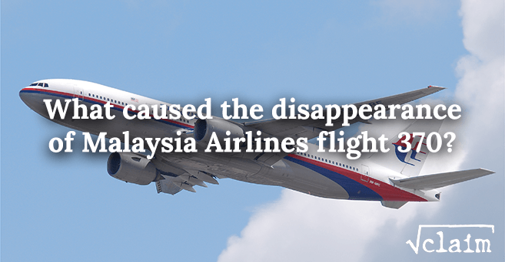
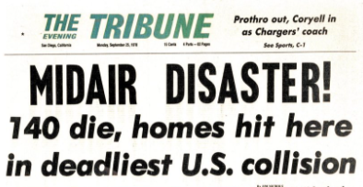
“It is extraordinary how safe flying has become. You are now statistically more likely to be elected president of the United States in your lifetime than you are to die in a plane crash. What an amazing achievement as a society! But what we end up focusing on are the catastrophic failures that are incredibly rare but happen every now and then.” – Steven Johnson
Notes:
Media thrives on big sensational stories, and a plane crash is definitely sensational. However, are they giving the entire picture? Today I’m here to talk to you about how safe air travel is, and why you should be taking the stories from the media with a grain of salt.

Slide 4





Odds of Dying (General Population Risk Per Year) 1999-2003
1 out of 7,700
1 out of 410,000
1 out of 91,500
1 out of 2,067,000
1 out of 306,000
Notes:
Possibility of dying in a car crash is 268x more likely to happen than dying in a plane crash.

Slide 5
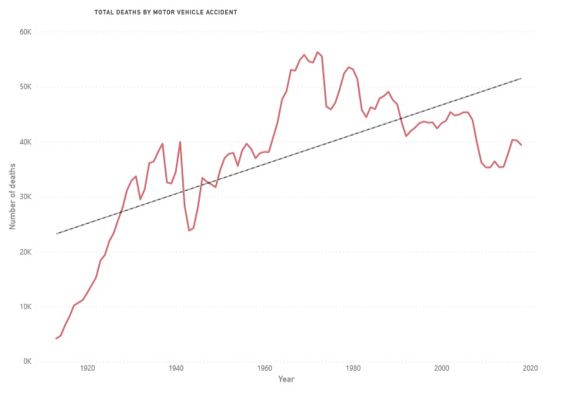
Motor Vehicle Deaths 1913-2018
Peak Fatalities
56,278
Trend going up

Slide 6
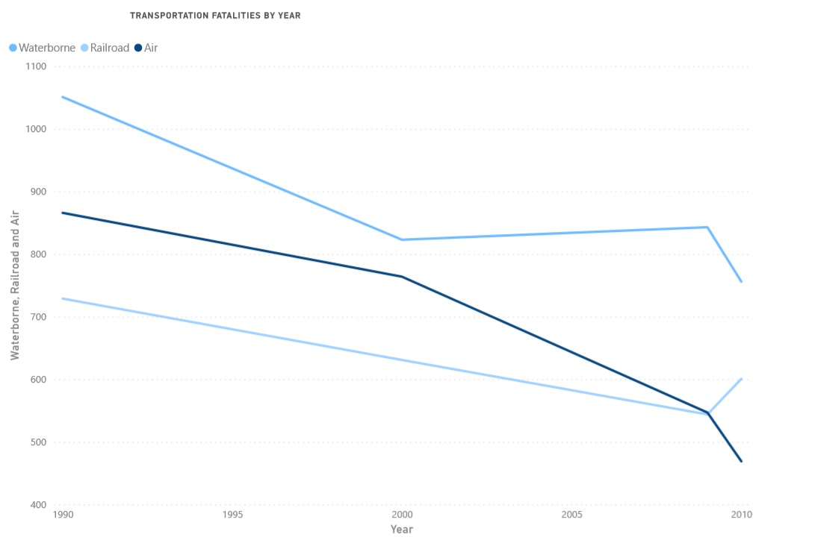


Other Transportation Fatalities
Peak Fatalities
Waterborne = 1,051
Airplane = 886
Train = 729
All trending downward

Slide 7
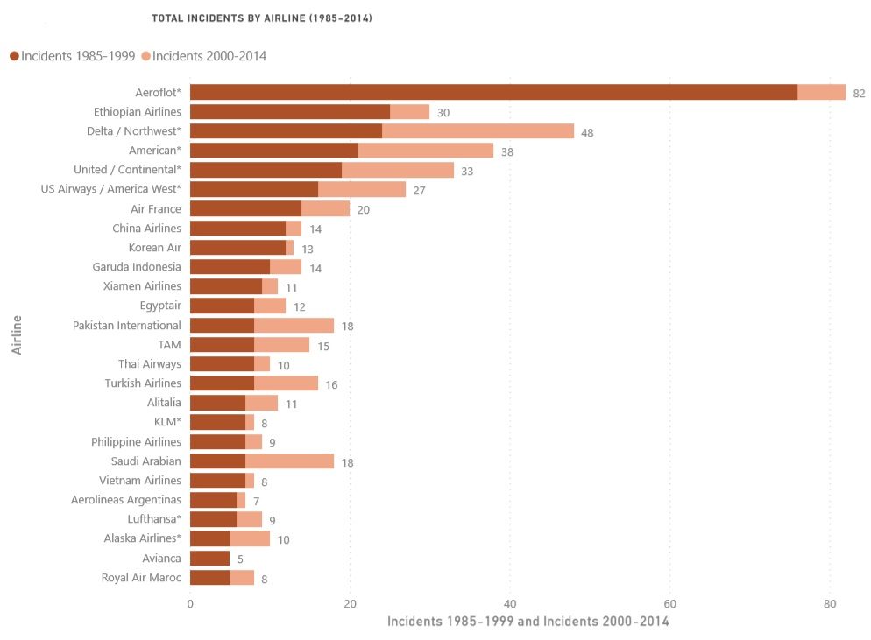
Why are Incidents different?
Incident = Not an accident
(49 CFR 830.2 - Definitions, 1988)
Notes:
Incidents means an occurrence other than an accident that is associated with the operation of an aircraft, but does not result in loss of human life.
Average incidents 1985-1999 = 7.18%
Average incidents 2000-2014 = 4.13%
Difference of 3.05%

Slide 8
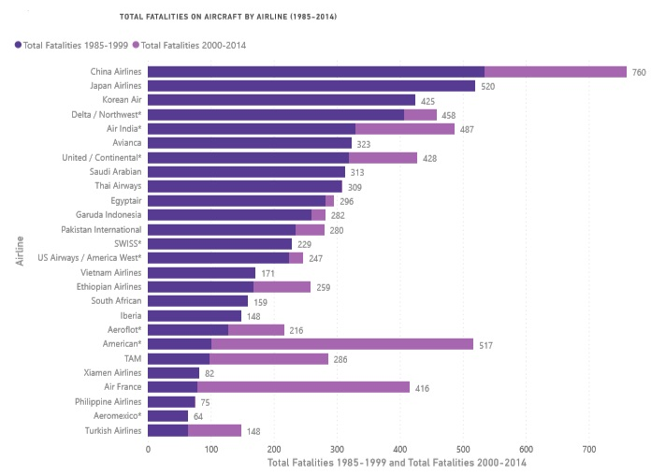
Total Fatalities
Total Fatalities = All deaths on aircraft
Notes:
Total fatalities covers all deaths that happen on an aircraft. This could be from an accident, but it could also be someone had a heart attack mid-flight and expired.
Average total fatalities 1985-1999 = 112.4
Average total fatalities 2000-2014 = 55.5
Difference of 56.9
Why is this important? Because it doesn’t just cover accidents, but spans all fatalities on an aircraft. It’s also worth noting that there is a significant decrease in these fatalities from 1985-1999 to 2000-2014

Slide 9
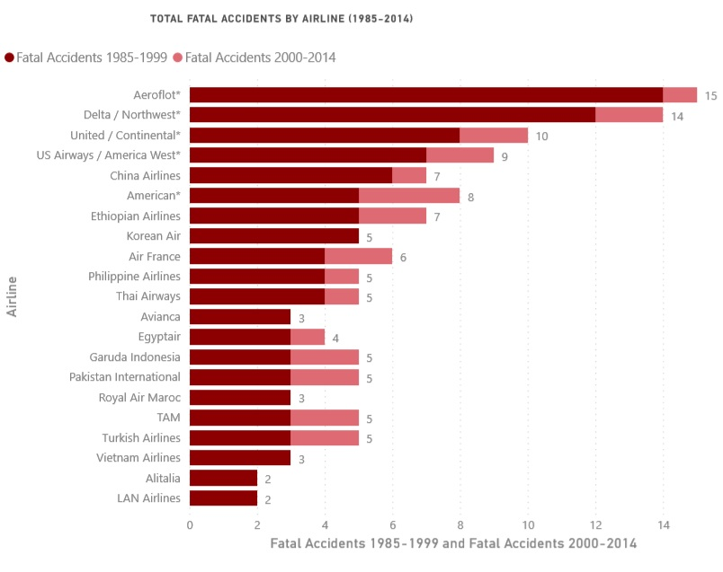
Fatal Accidents
Fatal accident = Accident resulting in death
(Accident Classification, 2017)
Notes:
A fatal accident is one that causes one or more fatalities to the occupants of the aircraft.
Average fatal accidents 1985-1999 = 2.18%
Average fatal accidents 2000-2014 = 0.66%
Difference 1.52%

Slide 10

Takeaways
Do your own research
Report misinformation
Nervous about flying?
Know what to expect
Sit away from the window
Don’t watch movies or news where plane crashes are present
Breathe or meditate
(Schlichter, 2021)
Notes:
Know what to expect – familiarize yourself with the basics of how airplanes work and/or the plane itself

Slide 11
References - Data
Ropeik, D. (2006, September). How Risky is Flying? Retrieved from Nova: https://www.pbs.org/wgbh/nova/planecrash/risky.html#:~:text=The%20annual%20risk%20of%20being,is%20about%201%20in%205%2C000
49 CFR 830.2 - Definitions. (1988, September 23). Retrieved from Cornell Law School: https://www.law.cornell.edu/cfr/text/49/830.2#:~:text=Incident%20means%20an%20occurrenc e%20other,affect%20the%20safety%20of%20operations.&text=(2)%20The%20aircraft%20has% 20a,greater%20and%20sustains%20substantial%20damage.
Accident Classification - SKYbrary Aviation Safety. (2017, December 13). SKYbrary. https://www.skybrary.aero/index.php/Accident_Classification#:~:text=Fatal%20Accident%3A%20An%20accident%20causing,single%20fatality%20without%20substantial%20damage
Mehta, D. (2014, February 9). Airline Safety. Retrieved from GitHub: https://github.com/fivethirtyeight/data/tree/master/airline-safety
Car Crash Deaths and Rates - Injury Facts. (n.d.). Retrieved from Injury Facts: https://injuryfacts.nsc.org/motor-vehicle/historical-fatality-trends/deaths-and-rates/
CDC WONDER. (n.d.). CDC. Retrieved March 6, 2021, from https://wonder.cdc.gov/
Schlichter, S. (2021, February 18). If You’re Scared Of Flying, Read This. SmarterTravel. https://www.smartertravel.com/fear-flying-18-ways-cope/

Slide 12
References - Pictures
https://www.miniphysics.com/physics-of-airplane-flight.html
https://www.vox.com/the-goods/2019/4/19/18485015/airplane-blue-lighting-delta-jetblue-united
https://www.sandiegouniontribune.com/news/local-history/story/2020-09-25/from-the-archives-psa-crash
https://www.indiatoday.in/fact-check/story/fact-check-old-pictures-of-air-mishaps-linked-to-indonesia-plane-crash-1758316-2021-01-12
https://www.pe.com/2017/09/11/photos-remembering-the-911-terrorist-attacks-on-16th-anniversary/
https://www.baltimoresun.com/from-the-archives-40-years-ago-americas-deadliest-plane-crash-killed-273-people-story.html
https://www.bbc.com/news/world-middle-east-51044996
https://siliconcanals.com/news/airplane-travel-tips-to-fly-like-a-pro/

